Slide 1

ANNEX COLLAGE
“WEATHER FORCASTING APP”
ARPAN DASGUPTA (BCA)
TANMOY SANTRA (BCA)
DEPT. OF CSE
UNDER THE SUPERVISIONO OF
ATIKUL ISLAM
PROFESSOR
DEPT. OF CSE

Slide 2
Introduction
Overview: This weather forecasting app allows users to get real-time weather information using a simple and intuitive interface.
Technologies Used:
HTML for structure
CSS for styling
JavaScript for functionality
API for fetching weather data

Slide 3
App Features
User Input: Users can input a city name.
Real-time Weather: Displays current weather, temperature, humidity, and wind speed.
Weather Forecast: Shows a 5-day weather forecast.
Interactive Interface: Clean and easy-to-navigate design.

Slide 4
Weather API
Overview: The app uses a weather API to fetch real-time weather data.
API Used: OpenWeatherMap API
API URL: https://api.openweathermap.org/data/2.5/weather
API Key: You need to sign up on OpenWeatherMap to get a free API key.

Slide 5
How the App Works
Flow of the App: User enters the city name in the input box.
User clicks "Get Weather" button.
The JavaScript function fetches data from OpenWeatherMap API.
The weather information is displayed on the page.

Slide 6
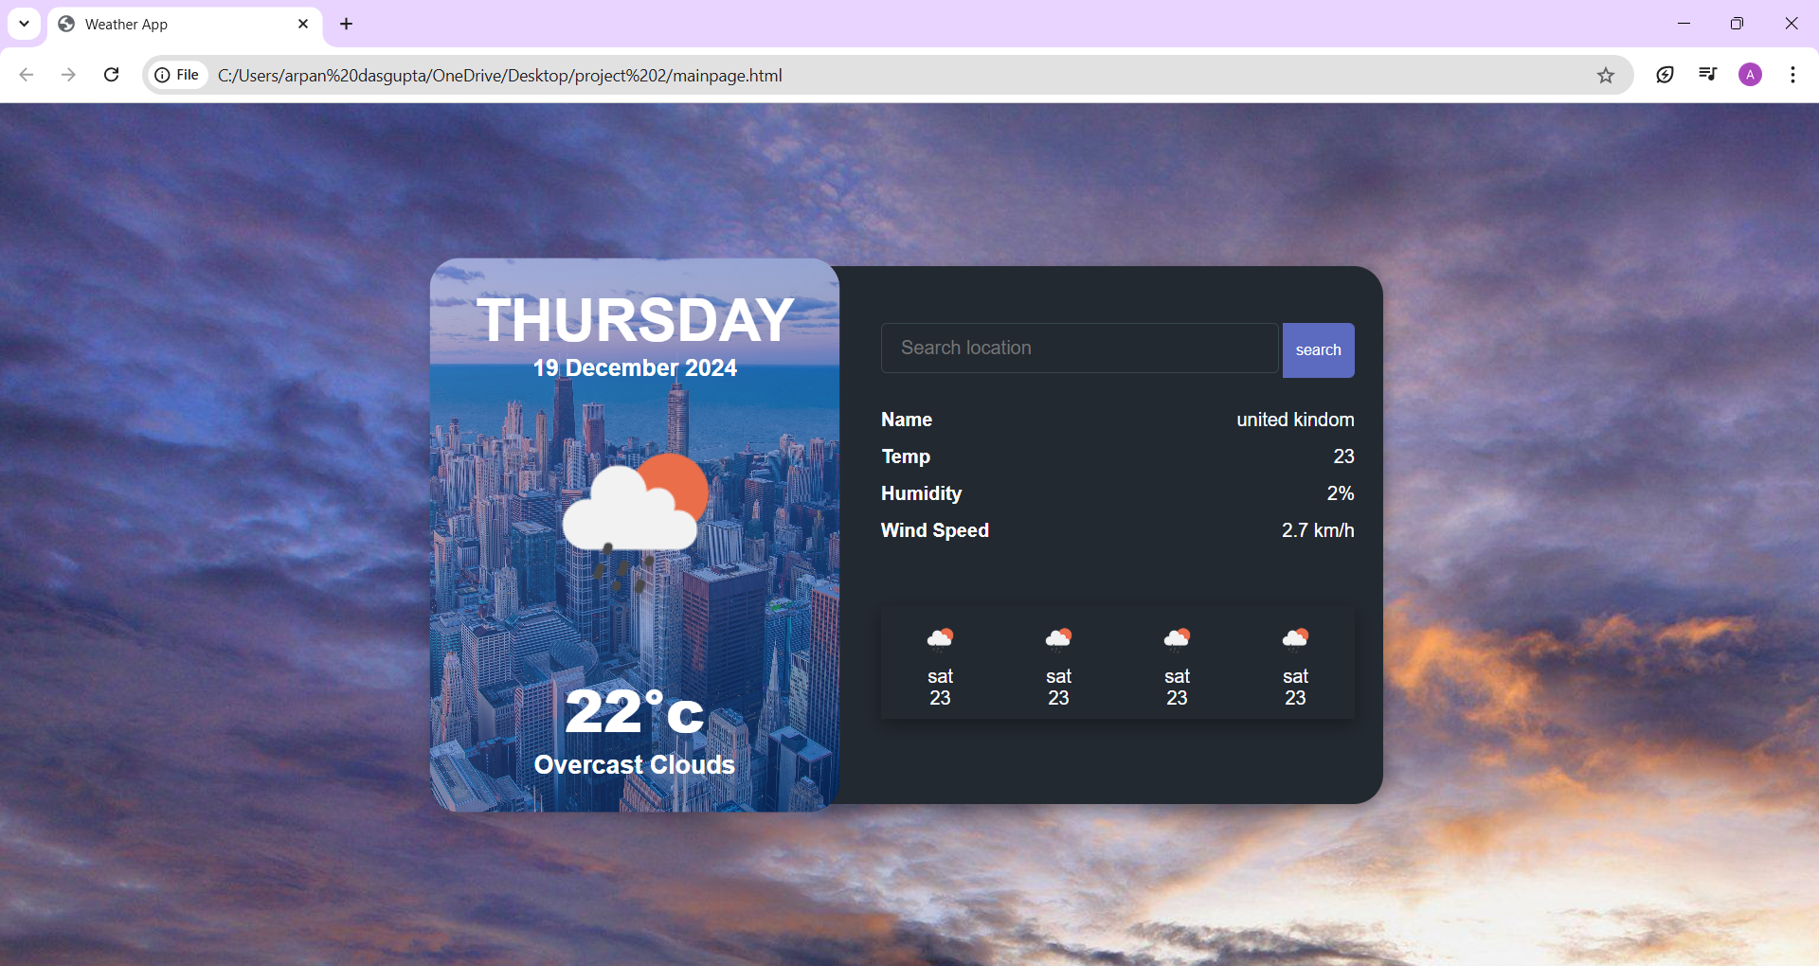
Result (Screenshots/Live Demo)

Slide 7
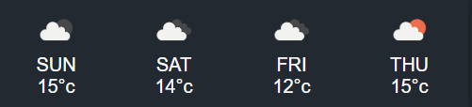
Result (4 DAYS FORCASTING )

Slide 8
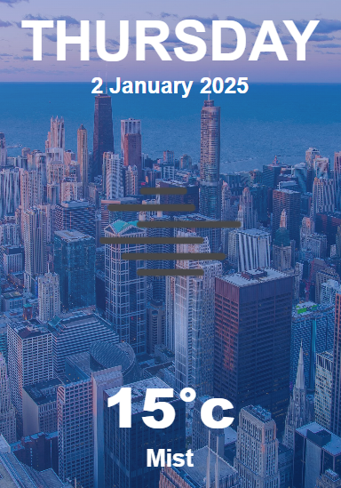
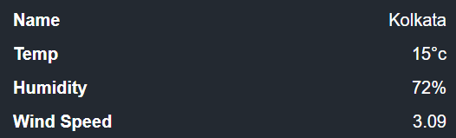
Result (LIVE FORCASTING OF SELECT CITY)

Slide 9
Conclusion
Summary: The Weather Forecasting App is a simple yet powerful tool for checking weather information using HTML, CSS, JavaScript, and APIs.
Future Enhancements:
Add a 1-month forecast.
Include more detailed information (e.g., pressure, visibility).
Use a more advanced weather API for additional features.

Slide 10
Reference
www.Image.com
www.Openweathermap.in
www.Onlineittuts.in
www.Google,com

Slide 11
Thank you

